Slide 1
Practice- 3.0
Sean G. Boynes, DMD, MS
Director of Interprofessional Practice

Slide 2
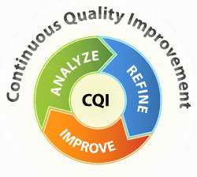
A QI Environment

Slide 3
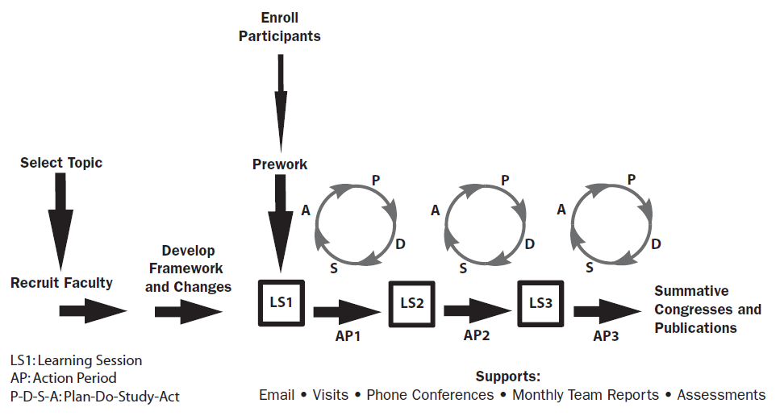
Notes:
In South Carolina, the SORH QICs worked with each of the RHCs during regular check-in calls; site visits; and data exchange, as a means to determine opportunities and challenges that occurred within each of the action periods of the collaborative. In addition, all 5 SC clinics have Patient Centered Medical Home (PCMH) certification and plan to use this collaborative to complete the improvement project work required for re-certification. The Colorado Rural Health Center (CRHC) has also recently invested in an IC position and the Pennsylvania SORH incorporated the IHI training into tasks prescribed for their oral health leadership position, due to the success of the SC SORH model. IHI offers training and educational opportunities so organizations can expand improvement leadership and expertise (www.ihi.org).

Slide 4
The Appointment Experience Process
1
2
3
Reception/Intake
Account Initiation/Update
Clinical Care
Patient Coordination
Account Management

Slide 5
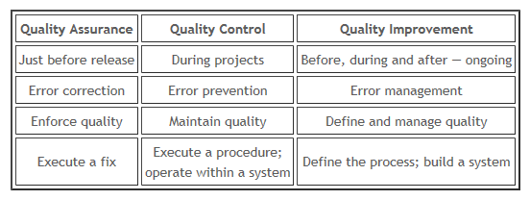
Notes:
Health care tends to combine these two (arrows), is this really wise – lead into next slide
QC – “fix it review”
QA – “continuous review”
QI – “achieve it review”

Slide 6
QA-QC-QI Functioning Together
1
2
3
Reception/Intake
Account Initiation/Update
Clinical Care
Patient Coordination
Account Management

Slide 7
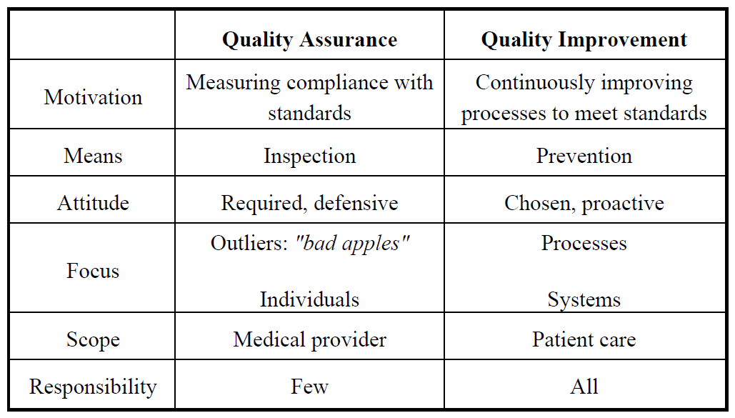
Quality Control
Are variables considered here?
http://www.hrsa.aquilentprojects.com/healthit/toolbox/HealthITAdoptiontoolbox/QualityImprovement/whatarediffbtwqinqa.html
Notes:
Testing for quality isn't assuring quality, it's controlling it. Quality Assurance makes sure you are doing the right things, the right way.

Slide 8
QC >>> QI
1
3
Reception/Intake
Account Initiation/Update
2
Patient Coordination
Account Management
Clinical Care
Notes:
Consider - a place for health and life not to avoid dying……

Slide 9
Questions & Discussion

Slide 10
Metric Overload and the Headache of HIT

Slide 11
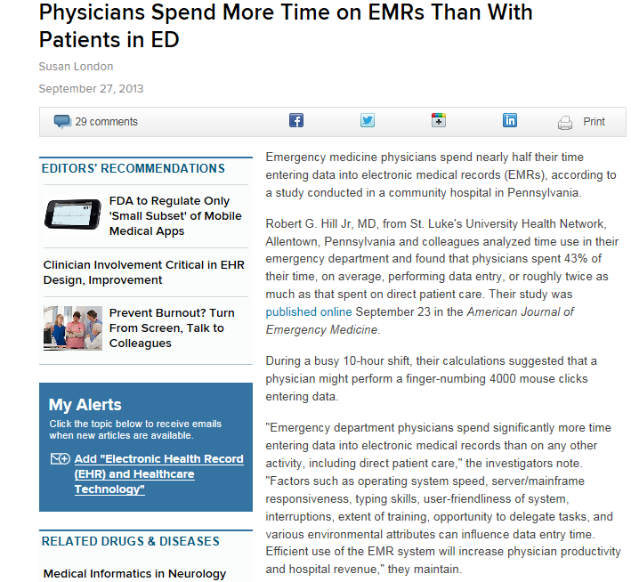
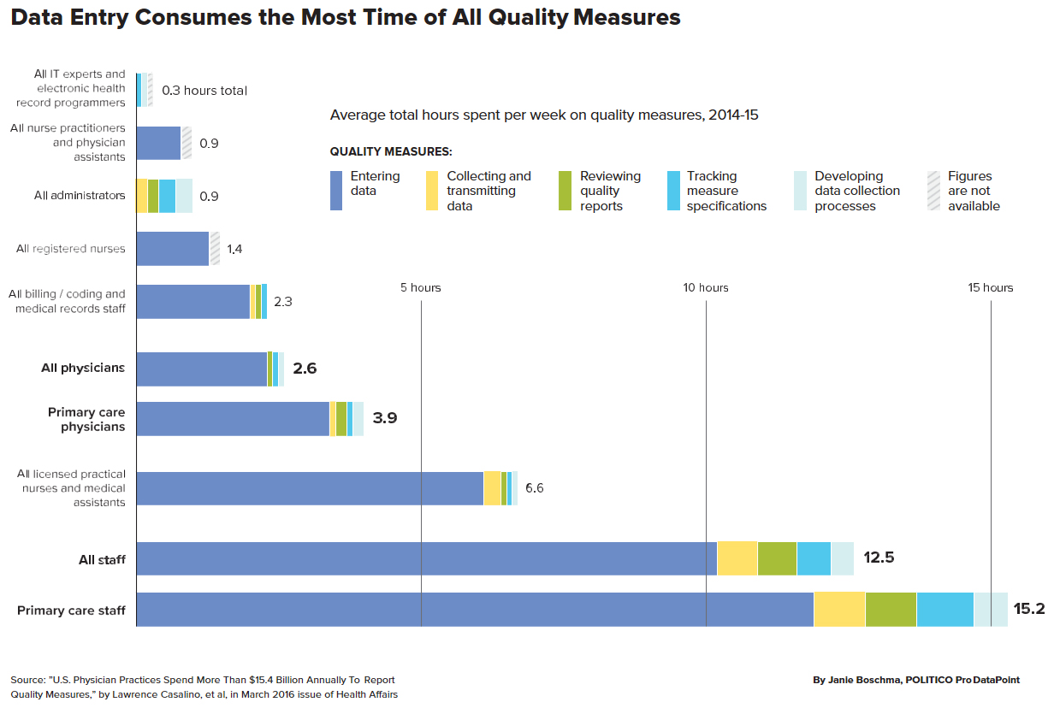
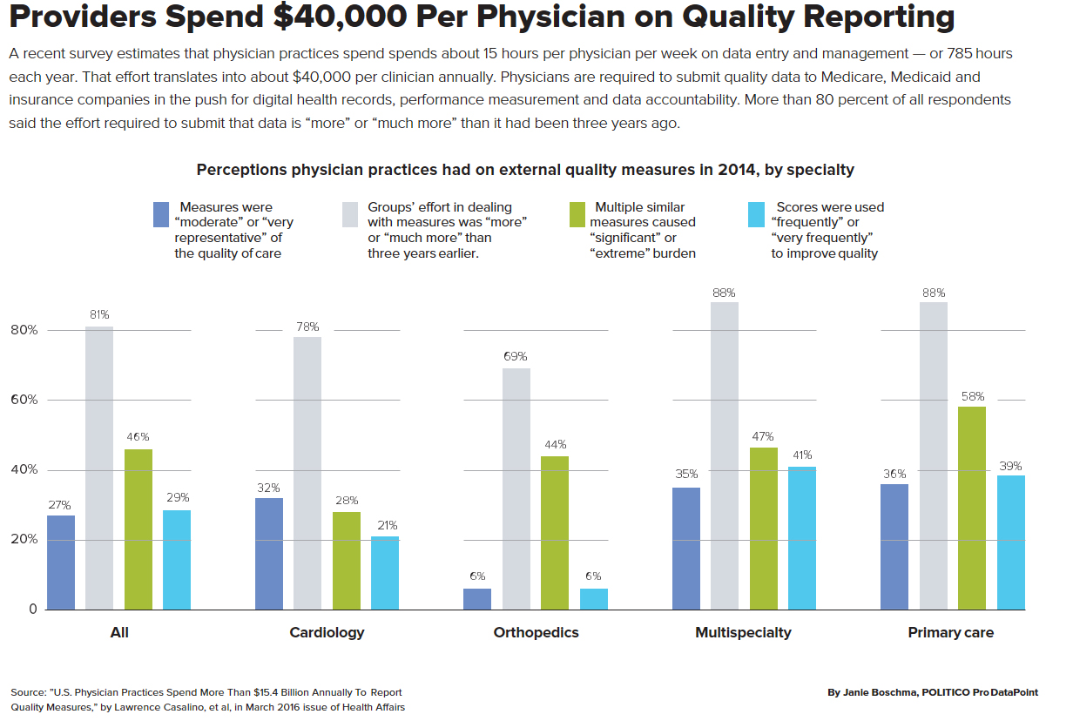

Slide 12
Notes:
Challenges middle column; opportunities right column
HIT Department at state office of rural health
Facilitates regulatory HIT information exchange
Involved in programs/initiatives that result in innovative solution for partners and affiliates
HIT infrastructure building
iCare Program
Improving communications and readmissions with rural hospital systems
Uses report writer program to provide timely quality indicator reports and real time information on chronic disease hospital readmissions

Slide 13
Open versus Closed HIT Systems
Open HIT systems
a multifaceted HIT system usually associated with network partners using different EHR/PMS programs, care teams located separately across a geographic region, a lack of effective communication between network partners, and/or comprised of multidisciplinary care teams and multiple operational models.
EHRs and PMS do not offer the functionality that result in adequate patient care communication between multi-disciplinary teams. There also is a lack of interoperability between different HIT programs/vendors.
Closed HIT systems
a single or interface based HIT program used within one care site or care system and all users must be part of a single organization, network, or business entity. All users share a common IT platform.
While some closed HIT systems can be upgraded to incorporate oral health measures and reporting mechanisms, it is often cost prohibitive for many clinics and dentists providing care in safety net programs

Slide 14
Challenges
New EHR versions or updates are being presented as a pathway to improved interoperability; however,
the cost associated with the program’s upgrade fees,
educating and training personnel, and
updating hardware systems, often proves too costly in a budget-neutral or cost-based environment.
Safety net programs affiliated with or parts of a hospital system were more likely to incorporate oral health measures into their EHR programs.
They also were most likely to have internal IT support compared to non-hospital system affiliated clinics.
The limitations with clinical data reporting, the cost of HIT, poor IT infrastructure, and lack of technical support stagnates interprofessional initiatives, especially in the rural environment.

Slide 15
Opportunities
Multiple solutions to the current lack of HIT interoperability are needed in order to ensure a level of health equity.
Report writing tools (RWT) show promise, especially in multi-disciplinary health networks with unrelated EHRs and PMS.
The RWT are devices programmed to capture, analyze, and report on data flagged for analysis.
While report writer programs show promise in reducing the total FTE and costs associated with quality improvement, more evaluation is needed to determine best practices.
It should also be noted that several health information exchanges are employing this data flow process and the use of report writers in HIT continues to grow.
As the need for quality metrics and reporting grows, business models will continue to appear and develop.
The health system is also observing the growth of third party organizations that provide population health, coordination of care, customizable reporting mechanism solutions, as well as, deliver ongoing HIT support.

Slide 16
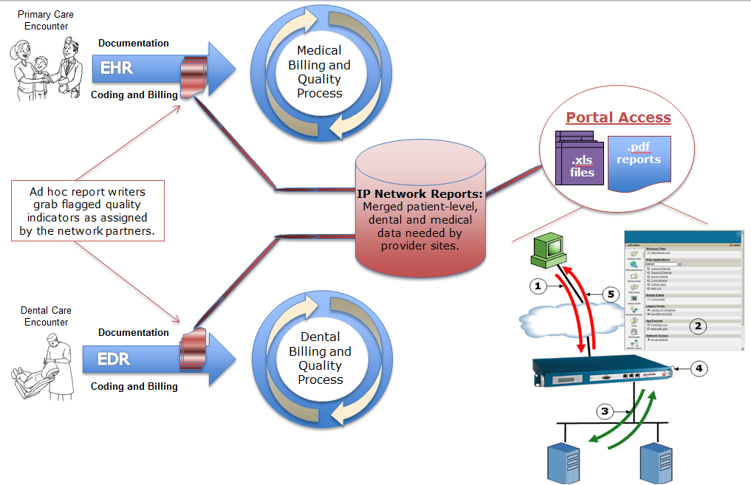

Slide 17
Questions & Discussion

Slide 18
Taking Advantage of the Profit Loss Report

Slide 19
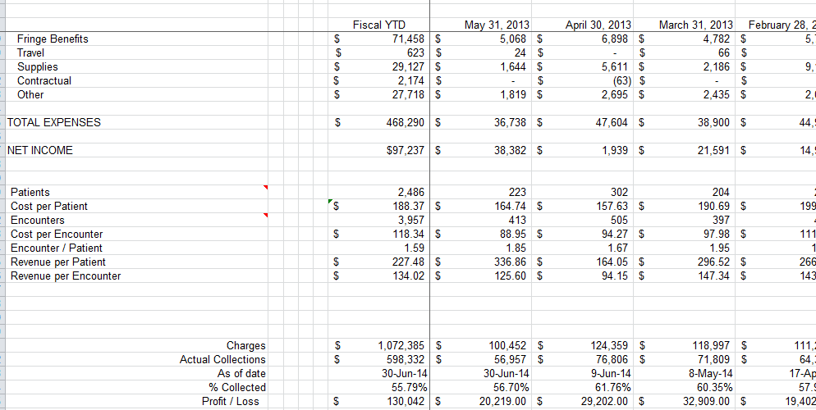
The P&L report
Notes:
Analyze according to discipline type of appt: preventive, restorative, o.s. can also go by patient type or payer mix; can also be used to evaluate personnel
DD are responsible for all the tasks assigned under their supervision and management
Avg. cost per encounter nationwide: $171 per UDS 2013
National average for collection percentage: private vs.
Dentist encounters: 2,500-3,200 per year
Dental hygienist encounters: 1,300-1,600 per year

Slide 20
Collection Percentage
Private practice metrics state goals of 98%
Not possible with FQHC business structure
No national benchmarks
Questions to ask to determine ideal collection rates:
What collection percentage do we REALISTICALLY need to maintain sustainable operations?
Is our collection process functioning at a high level and constantly reviewed for improvement?
How does our collection rate compare to national/state reimbursement reports?
Notes:
If you can achieve actualization with your collection rate then you can start to use collection improvement to improve budgeting and revenue.

Slide 21
Cost/Revenue per Encounter
These two metrics are vital to understand profitability of a dental program
Can use this metric to compare:
Provider and staff production
Break-down by code to see if specific services cost more or less
Compare different sites
Workflow performance

Slide 23
Notes:
Chair 1-3: Dr. Starr and Olivia
Chair 4-6: Dr. Harrison and Olivia

Slide 24
Questions & Discussion

Slide 25
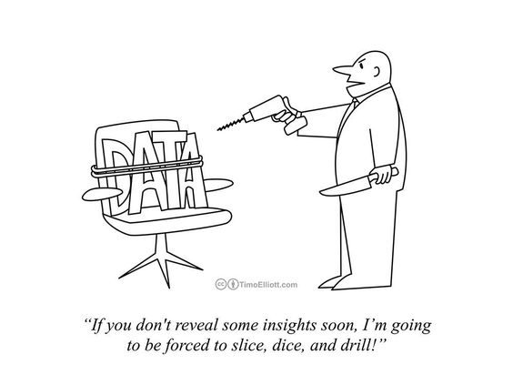
What data matters?

Slide 26
Lots of stuff to measure and so little time
Money
Safety
Personnel and Staffing
Patient Satisfaction
Effectiveness of care
Notes:
Disease management often referred to as the “medical model”
Areas of overlap between population health designs.
Interprofessional care

Slide 27
What do you measure, right now?
Gross Charges
Net Revenue
Expenses
Number of visits
Revenue per visit
Cost per visit
# of Unduplicated Patients
# of New Patients
# of Transactions
Broken Appointment Rate
Emergency Rate
Payer Mix Percentages
Scope of Service
# FTE Providers
# FTE Billing Staff
A/R past 90 days
# of Completed Treatments
# of children receiving sealants
# of sealants applied
% Children seen receiving a preventive service
Notes:
But doesn’t say how effective your care is

Slide 28
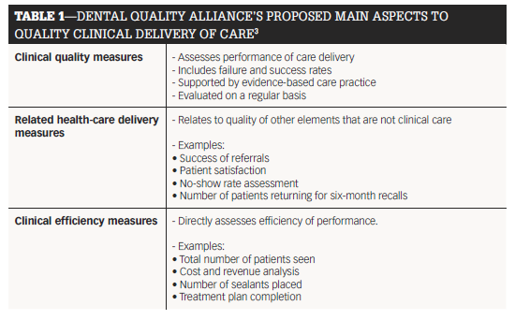

Slide 29
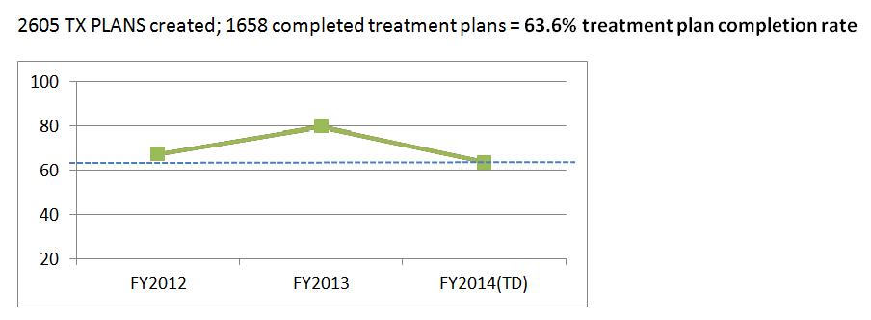
Treatment Plan Completion Rate

Slide 30
Growth and Impact

Slide 31
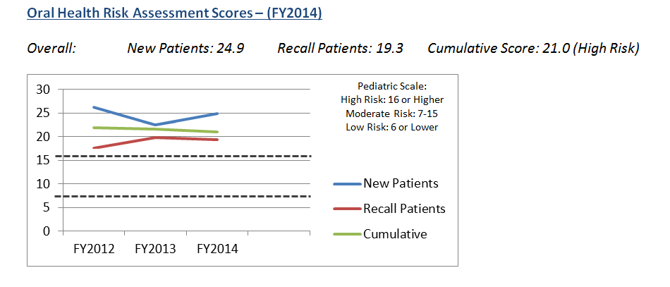
Risk Assessment

Slide 32
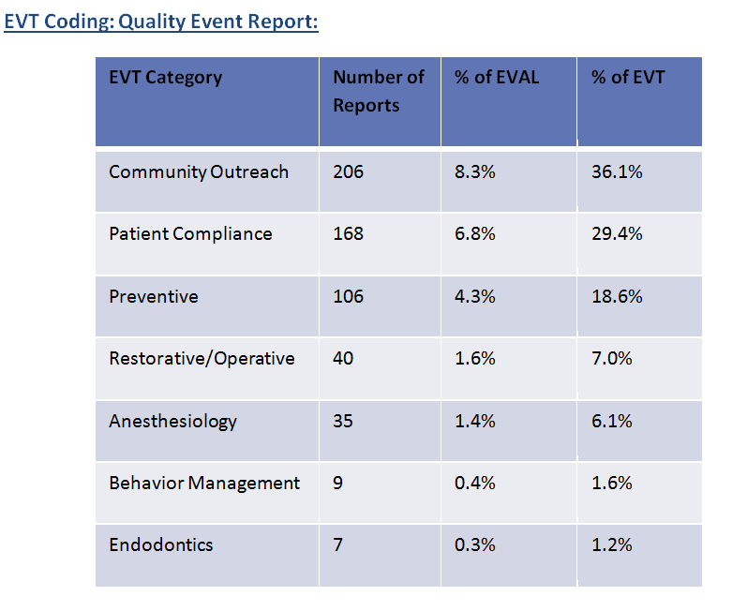

Slide 33
Questions & Discussion

